Slide 1






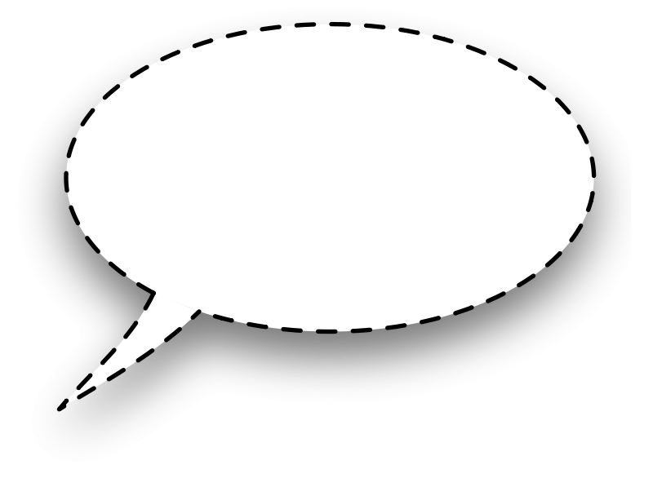
OPEN ENDED QUESTIONS - INFANT TODDLER
You are really
paying attention
to that
[name the focus
of attention]…
I see you reaching…
are you reaching for
[name the object
or person]?
You’re bouncing
up and down!
You look excited!
What is making
you feel excited?
I see you looking
over there…
are you looking
at the [name the
object or person]?
Are you trying to
tell me that you are
[name the emotion
suggested by the
child’s facial
expression]?
Do you want to
hold/touch/feel
the [name the object]?
Are you asking for
help from me?
[pause] Hmm, let’s
figure out what
you are
trying to do…
You have the blocks
all pushed together…
[pause] I wonder
what you are building…
Where did all the
water/sand
go when you
poured it?
What’s
happening
out that
window?
The red car and
the blue car are
driving…I think
the red car might
be going faster
than the blue car.
What do you think?
Hmm…I wonder
how you will fit
all of those blocks
into your bag?

